Slide 1



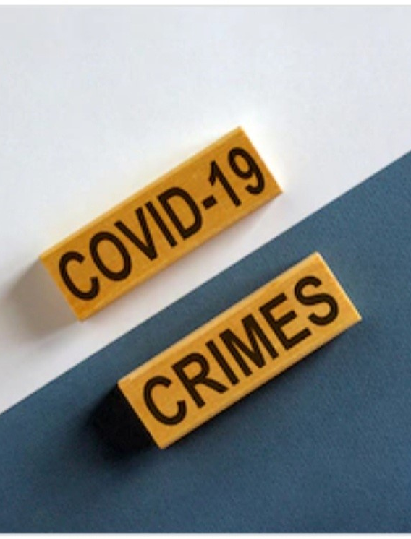
Criminal Activity Analysis Pre and post COVID19 Los Angeles
GROUP 4:
Rigo Vargas, Rubab Hussain, Hieu Le-Au, William Gass, Melissa Fenn, Briseyda Serna-Marquez

Slide 2
Implementation Workflow
Data Collection:
Data sets retrieved from LA City Data.
ETL:
Clean the data using the LA City Visualization tool, Excel, and SAP.
ETL:
Import Clean Data to SAP
ETL:
Set Dimensions, Measures, Properties, and Descriptions in SAP.
Data Modeling:
Create Interactive stories and models.
Coordination:
Visualization, Report, and Format for PowerPoint.

Slide 3


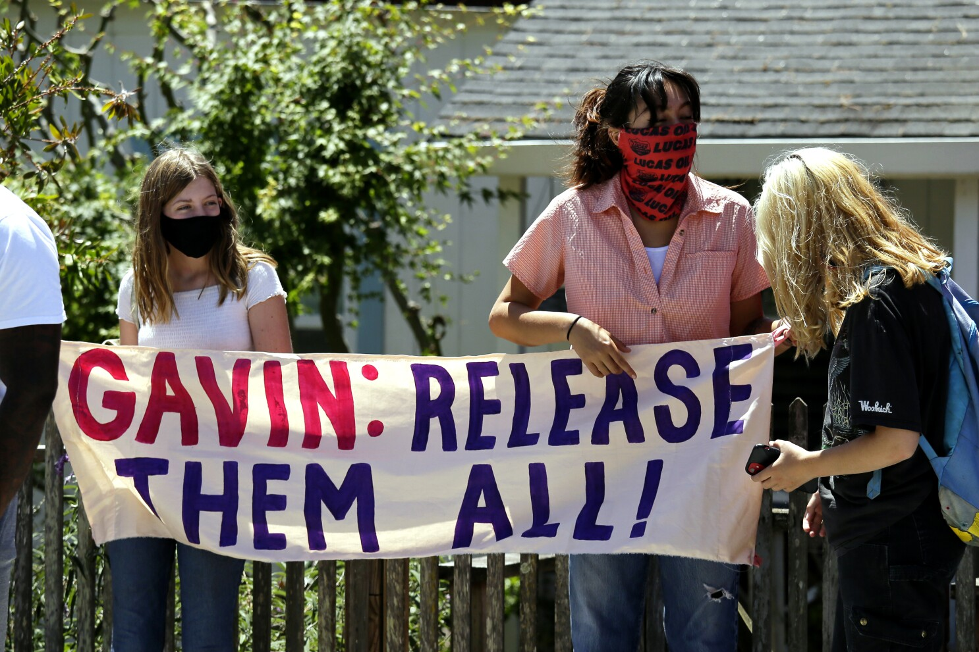

Project Description/Objective
Use aggregate crime data from different divisions in the city of Los Angeles to uncover patterns in criminal activity before and after COVID.
The objective is to see if juvenile crime rates went down during/post covid, with schools and other things being shut down.
Age is a factor that was analyzed – as the age number increases the likelihood of committing a crime follows the same trend.

Slide 4
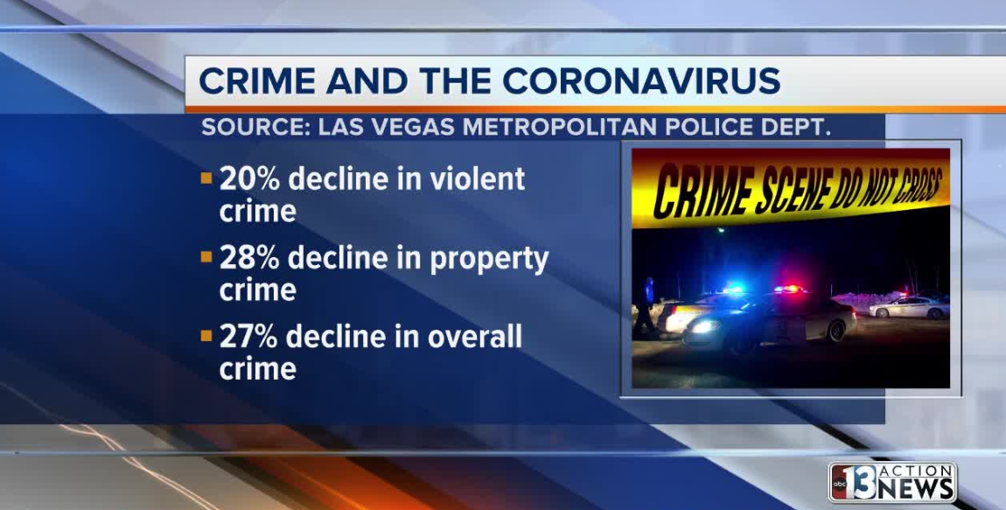
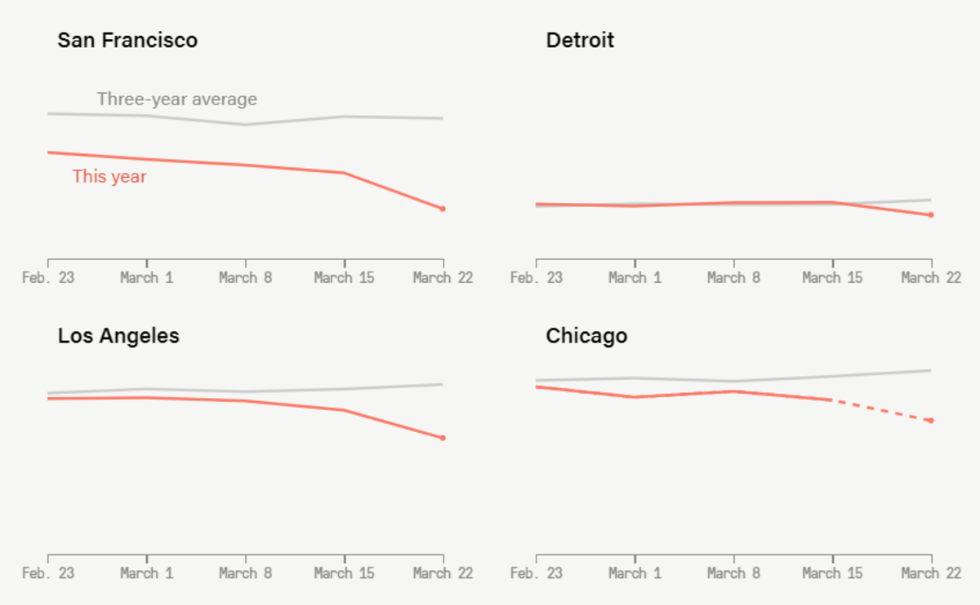

Research Questions to Answer:
Did crime rates change during/post Covid19?
Did the method of crime change?
Were different regions affected more than others?
Did the Covid year impact Juvenile crimes?
What do your results suggest about how best to distribute law enforcement resources pre and post Covid19.
Others: Data visualization of crimes pre and post Covid19.

Slide 5


Data Sets Used (Resources):
LA City Data Main Page [https://data.lacity.org/]
Crime Data from 2010 to 2019 [https://data.lacity.org/Public-Safety/Crime-Data-from-2010-to-2019/63jg-8b9z] (Size: 155.2 MB)
Crime Data from 2020 to Present [https://data.lacity.org/Public-Safety/Crime-Data-from-2020-to-Present/2nrs-mtv8] (Size: 151.9 MB)
LA County COVID Cases [https://data.lacity.org/COVID-19/LA-County-COVID-Cases/jsff-uc6b] (76 KB)
https://github.com/hleau/Hieu (data must be combined for geomap)

Slide 6
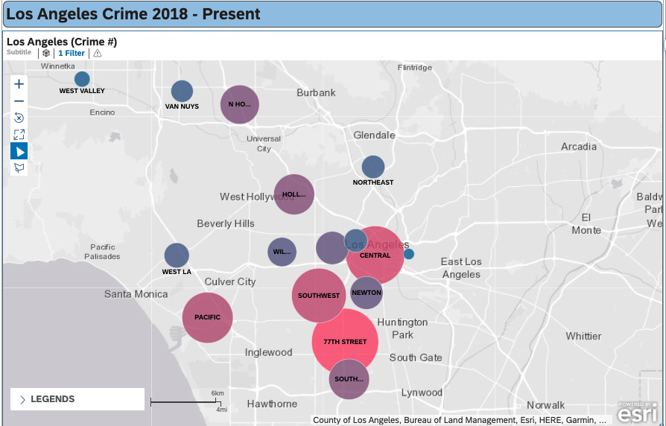
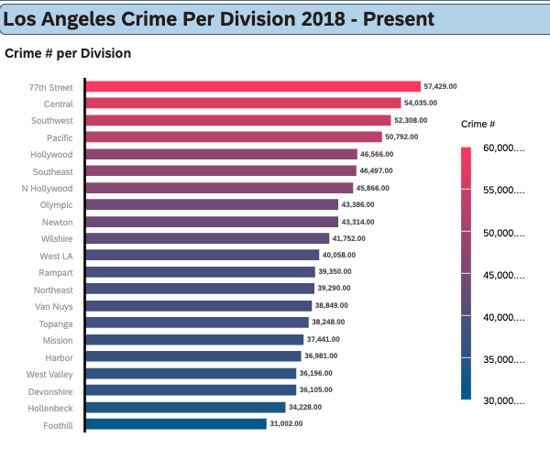
CRIME 2018 - Present
Question: In the calendar period, does the weather pattern correspond with the criminal activity occurring in the city of Los Angeles?
Initial Analysis of Numbers of Crimes Per Month:
In the first quarter of the year, Month 2 (February) has the lowest number of reported crimes in the year.
From Month 3 (March) to Month 8 (August), there is an increase in the reported crimes.
In the fourth quarter, there is a significant decrease in the reported crimes in comparison to the rest of the year.

Slide 7
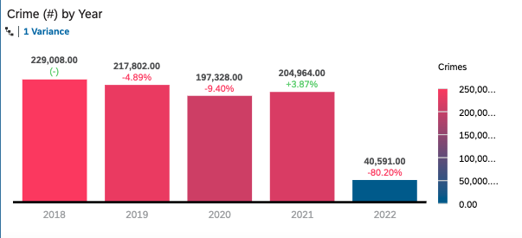
CRIME Before and after Covid

Slide 8
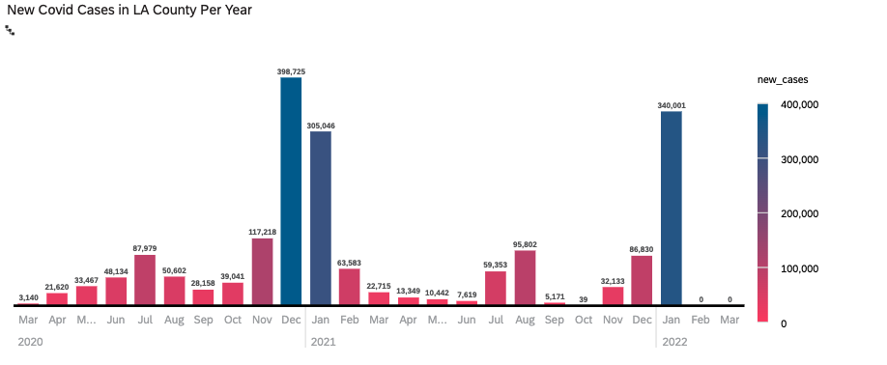
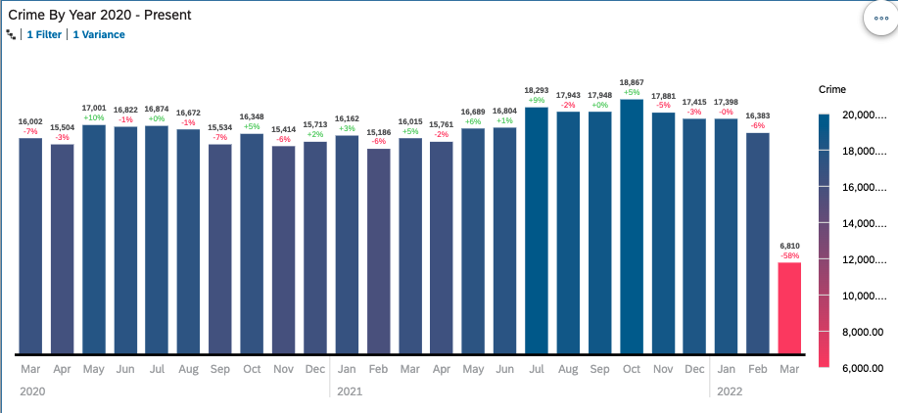
Covid cases compared to crime

Slide 9
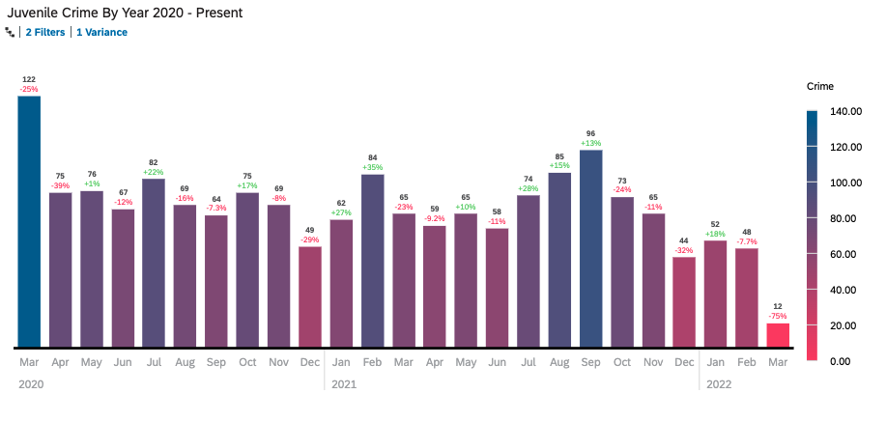
Covid cases compared to Juvenile crime

Slide 10
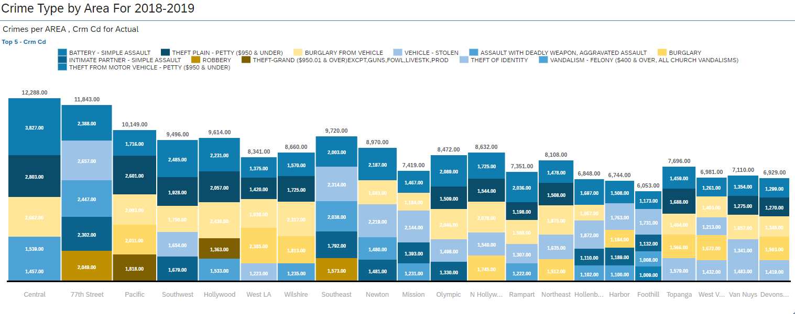
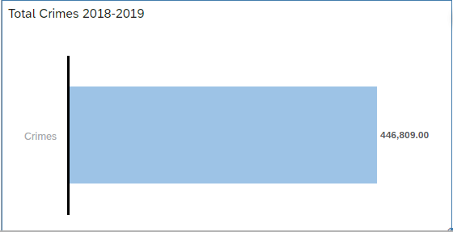
Did the method of crime change?

Slide 11
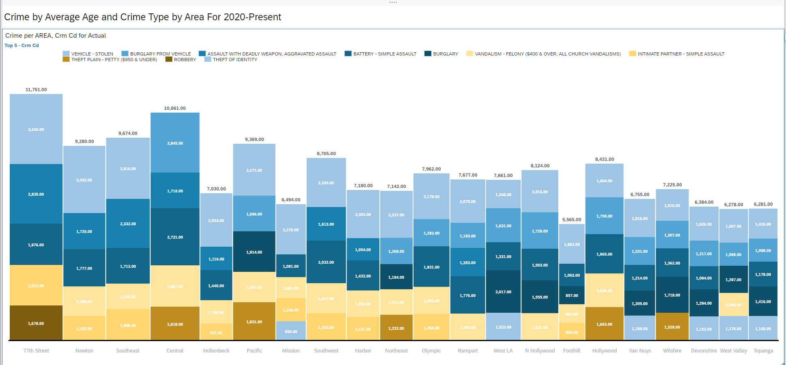
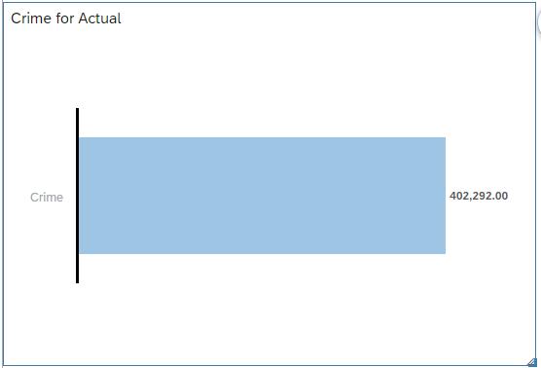
Did the method of crime change?

Slide 12
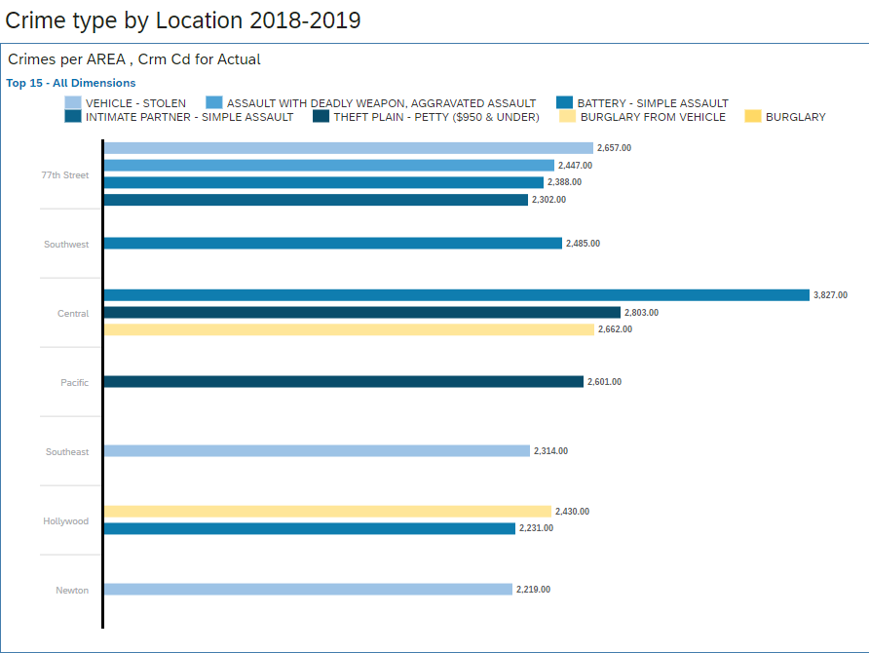
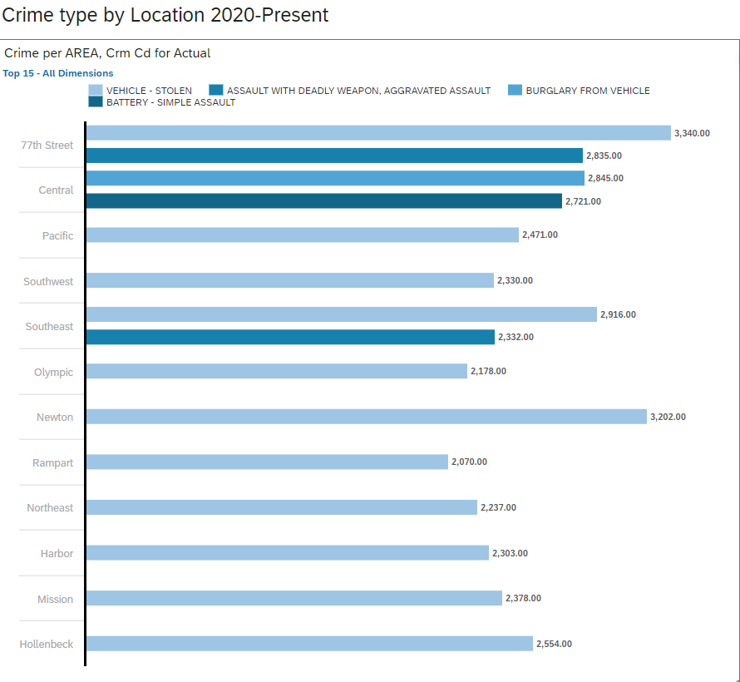
Did the method of crime change?

Slide 13
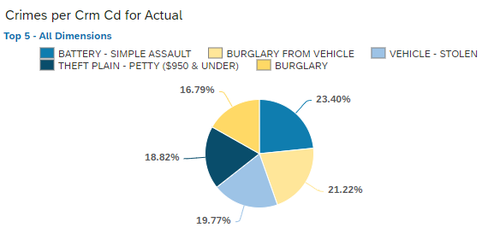
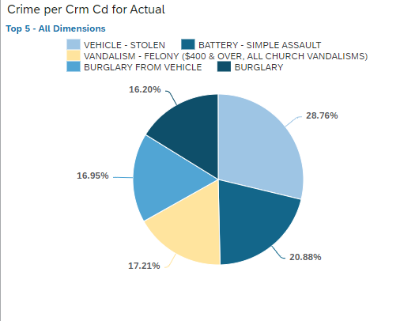
Did the method of crime change?
2018-2019
2020-Present
"The Pie didn't change; more like a variation from Classic Blueberry pie to Blueberry Galette, same pie different Presentation" -H.H

Slide 14
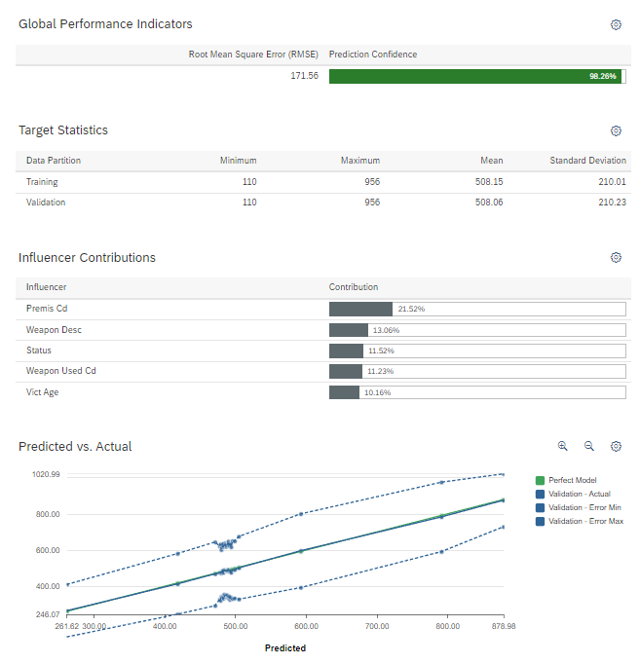
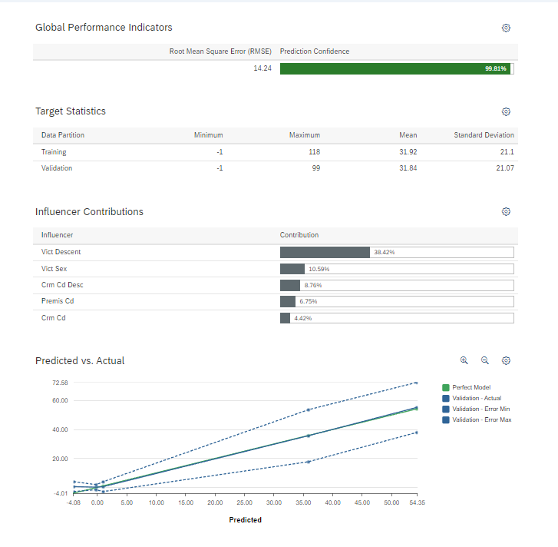
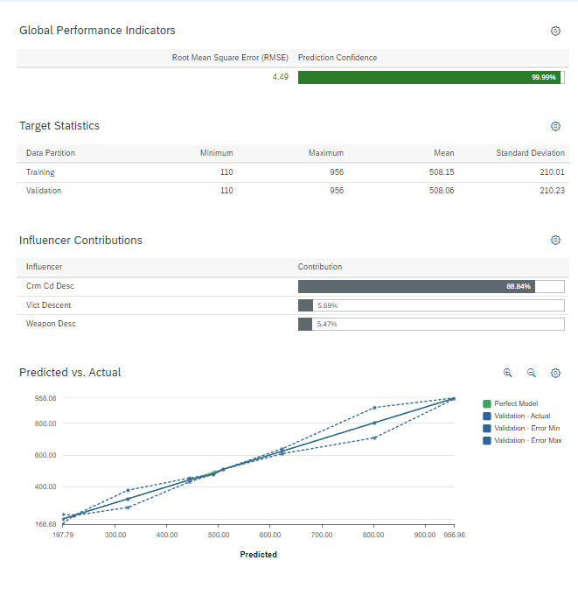
Did the method of crime change?
Crime 2018-2019
Crime Type
Age
Area

Slide 15
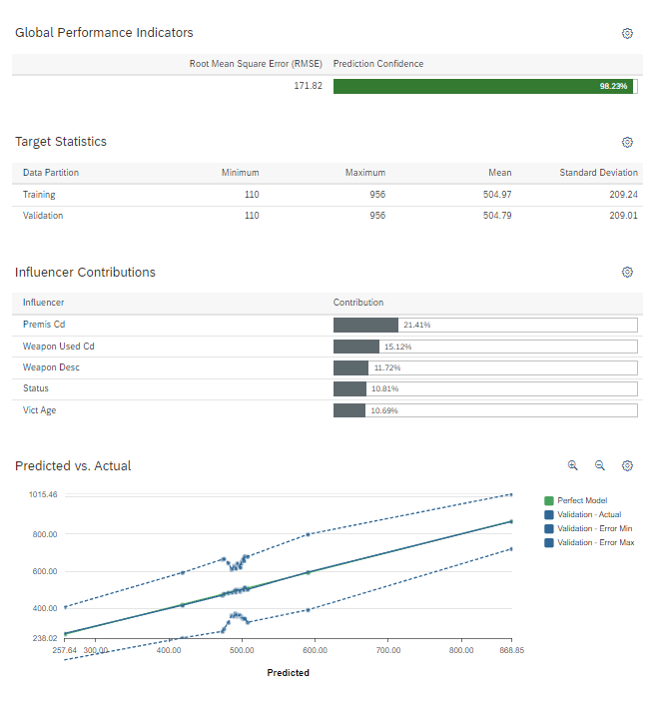
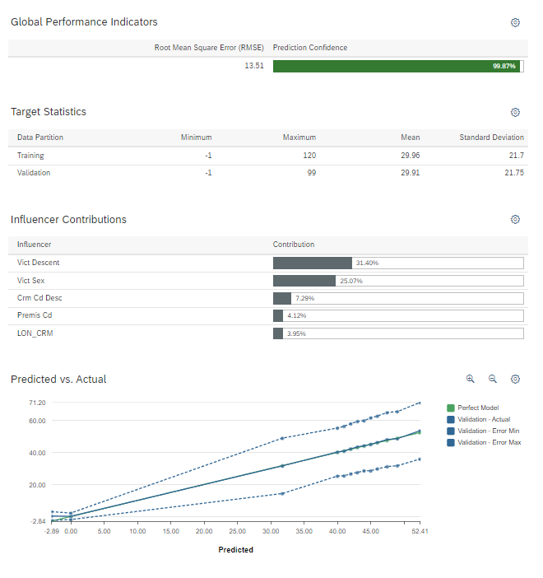
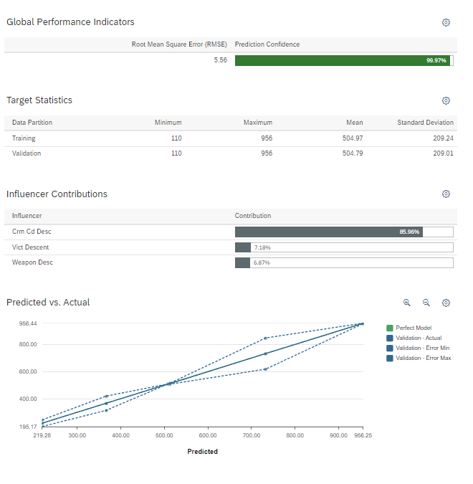
Did the method of crime change?
Crime 2020-Present
Crime Type
Age
Area

Slide 16
Did the method of crime change?
The relationship between 3 targets (Crime Type, Age, Area) Regressions show similar patterns
Meaning: there is little correlation between the pandemic and Crime
Something worth noting is Genders becomes more of an influence in 2020-Present compared to 2018-2019 when looking at Age as a Target

Slide 17
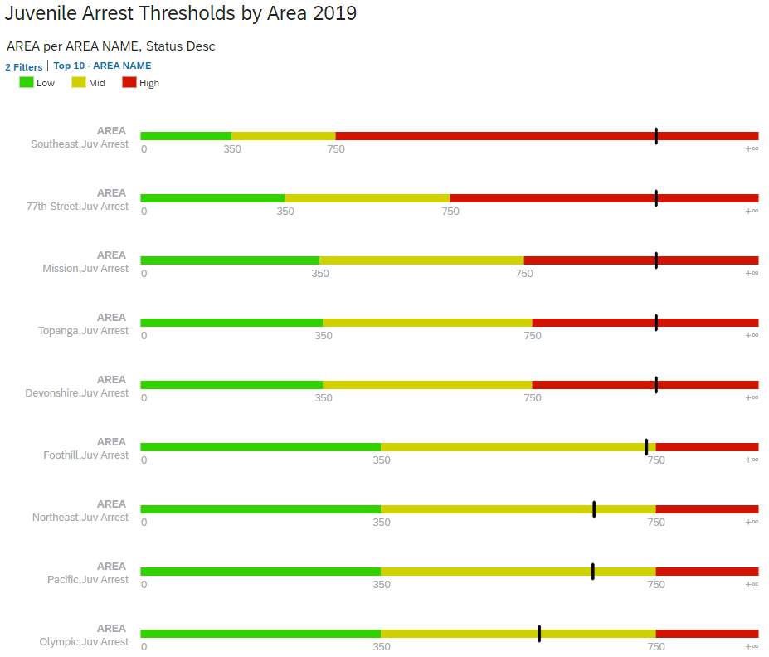
WERE DIFFERENT REGIONS AFFECTED MORE THAN OTHERS?
By doing a threshold analysis of arrests by area we can see which areas have an unusually high number of arrests.
In 2019 there were 5 areas that had what would be considered high numbers of juvenile arrests according to the parameters we set.

Slide 18
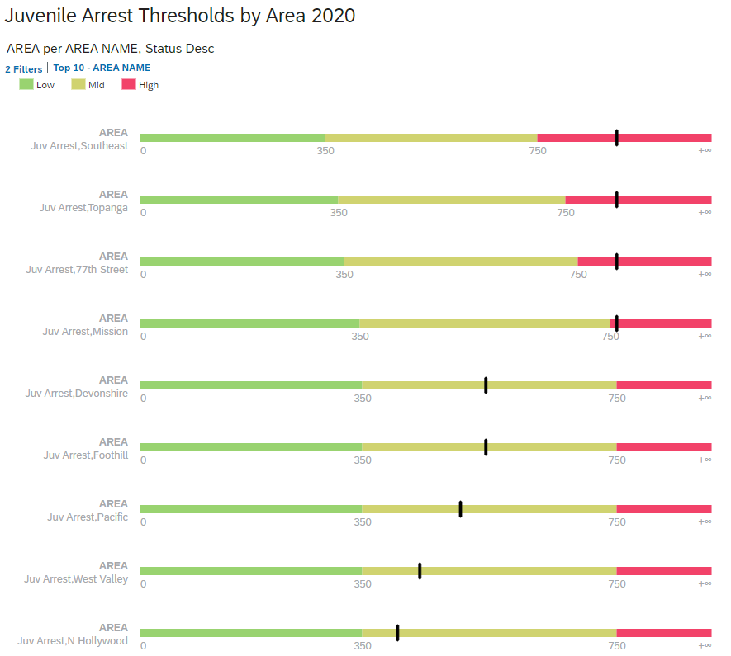
WERE DIFFERENT REGIONS AFFECTED MORE THAN OTHERS?
In 2020 the number of areas that had an unusually high number of arrests had dropped from 5 to 4.
Many of the same areas that had a high number of arrests in 2019 also had a high number of arrests in 2020.

Slide 19
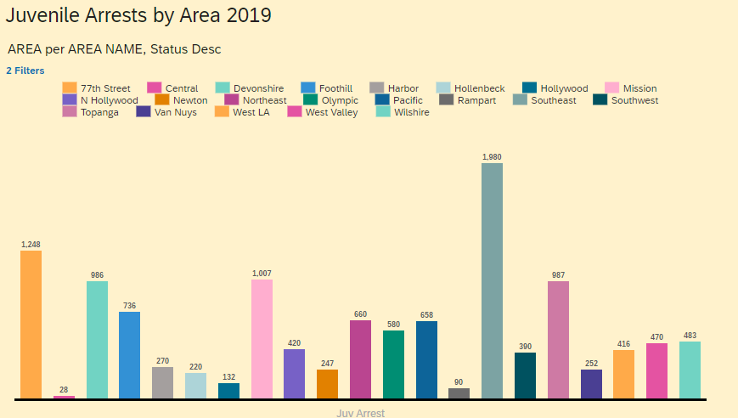
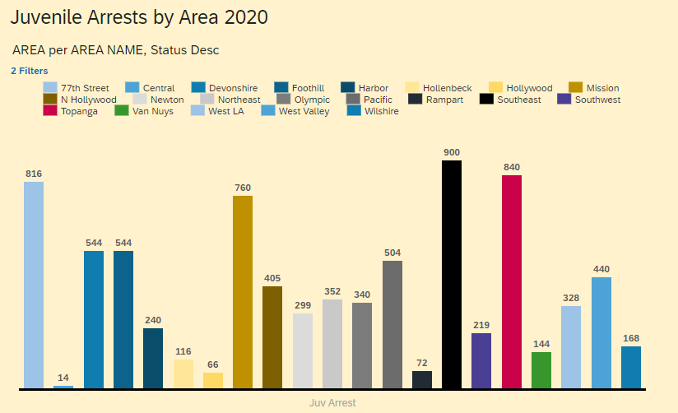
DID THE COVID YEAR IMPACT JUVENILE CRIMES?
We examined juvenile arrests in 21 areas within Los Angeles in 2019 and 2020.
There were 12260 juvenile arrests in 2019
In 2020 there were 8111 juvenile arrests...A 34% drop.

Slide 20
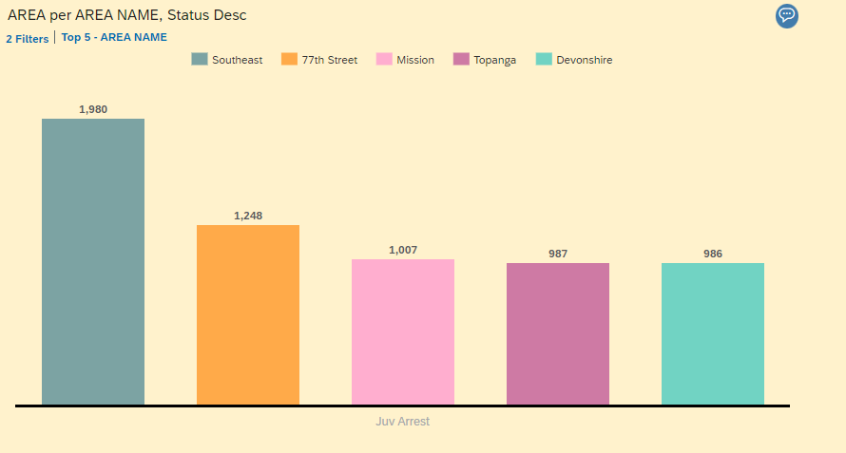
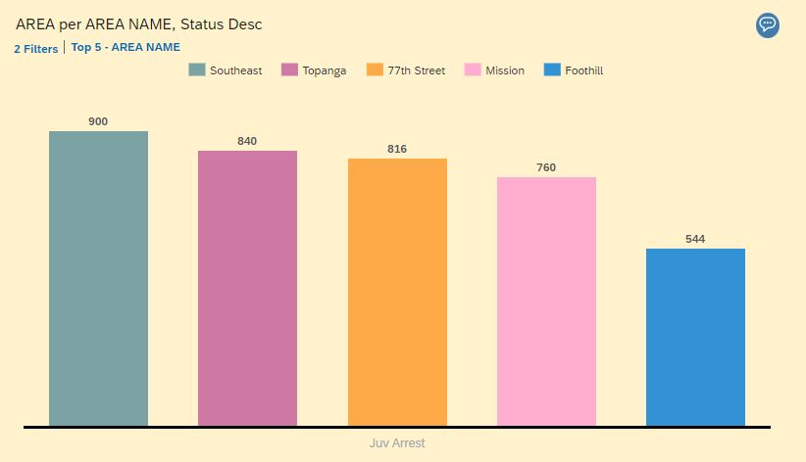
DID THE COVID YEAR IMPACT JUVENILE CRIMES?
Even though overall juvenile arrests were down in 2020, the areas where the most arrests occurred shifted.
The Devonshire area fell out of the top 5 areas for juvenile arrests, while the Foothill area joined the top five.

Slide 21
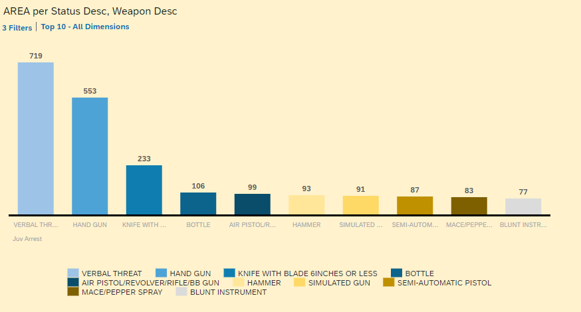
DID THE COVID YEAR IMPACT JUVENILE CRIMES?
We were also able to examen the types of weapons that were used in crimes that led to juvenile arrests.
Kicking and Punching was number one in both 2019 and 2020 by an overwhelming majority, so that was filtered out.
In 2019, the remaining top 10 types of weapons used varied substantially.

Slide 22
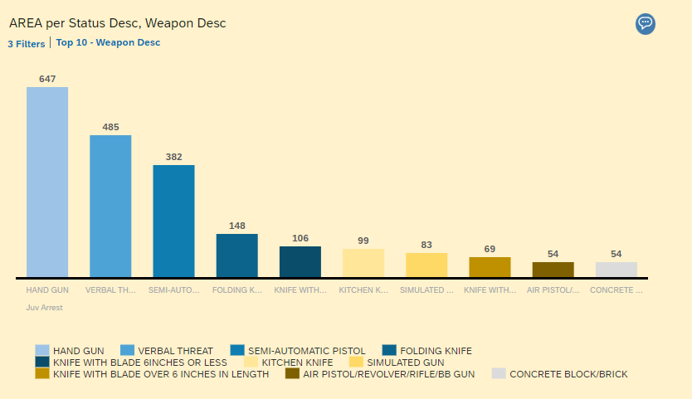
DID THE COVID YEAR IMPACT JUVENILE CRIMES?
In 2020, handgun use overtook verbal threats.
The list of weapons used in juvenile crimes that led to arrest was more homogenous, with 4 of the top ten being some form of knife.
Arrests involving the use of concrete blocks and bricks crept into the top ten.

Slide 23
What do your results suggest about how best to distribute law enforcement resources pre and post Covid19.
While additional analysis will need to be conducted, there is evidence that there was a shift in both the number of juvenile crimes that were committed, the areas that those crimes were committed in, as well as the types of crimes committed and weapons that were used.
By looking at the data, police can reallocate resources to the areas that need them most.
While juveniles are out of school, they may be inclined to use weapons that are commonly found in the house- especially knives. Police can use this information to better prepare themselves when responding to incidents that juveniles may be involved in.

Slide 24
Did the method of crime change? Conclusion
Main Take away:
There is little relationship between Crime and the Pandemic
Crime rates dropped during the pandemic by roughly 10% meaning Crime rate tends to be independent despite a global event
Type of Crimes saw a variation; less people were outside meaning less assault/battery (decline) and more vehicles Stolen ( increase) presumably due to people not driving as much.
Age has a plausible relationship, but inherently limited by factors such schooling, demographic, area, and specific age group.

Slide 25


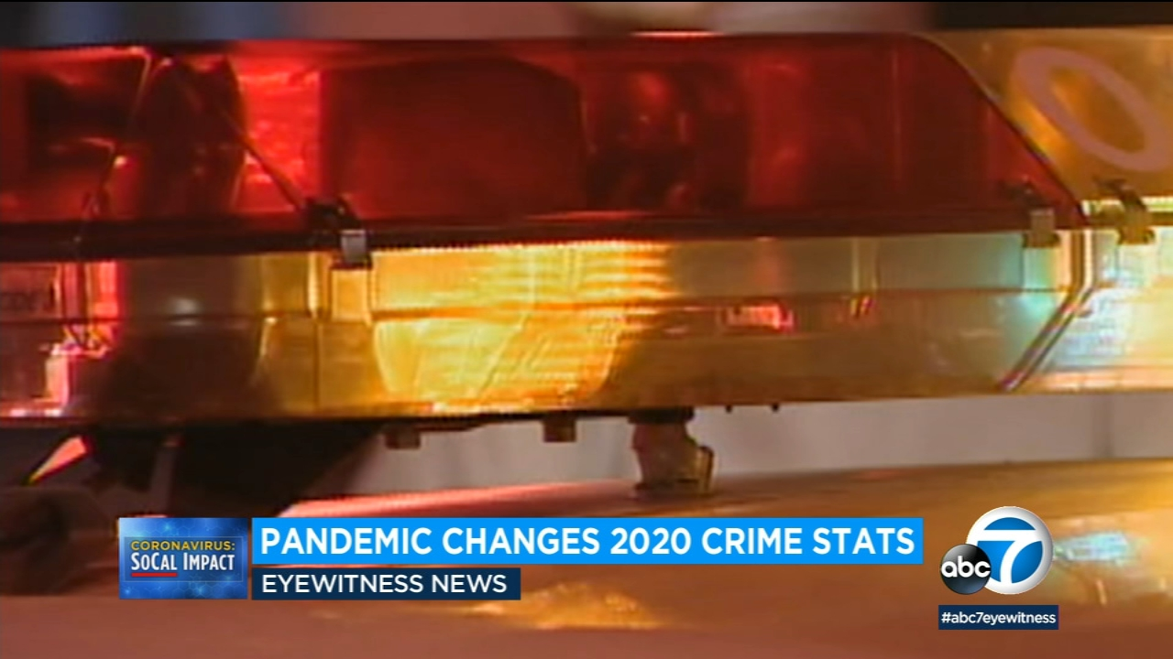

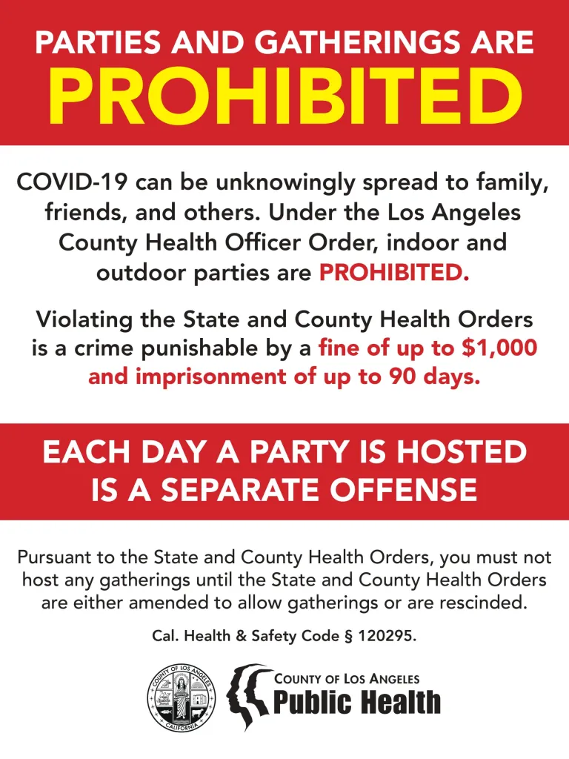
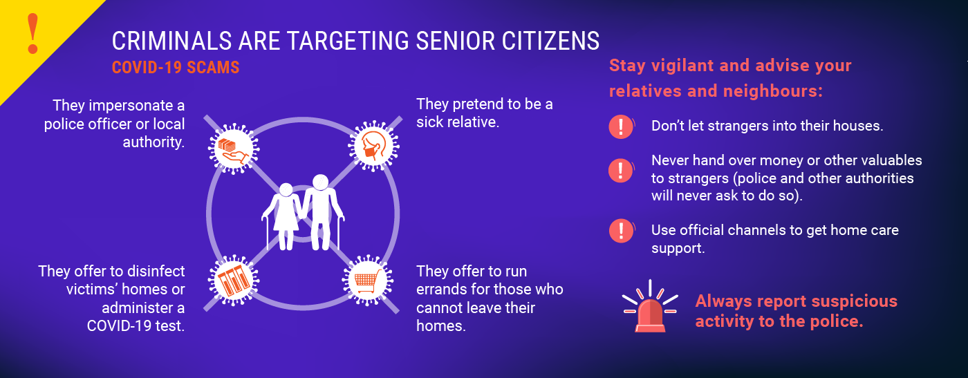


Questions?

